Slide 1
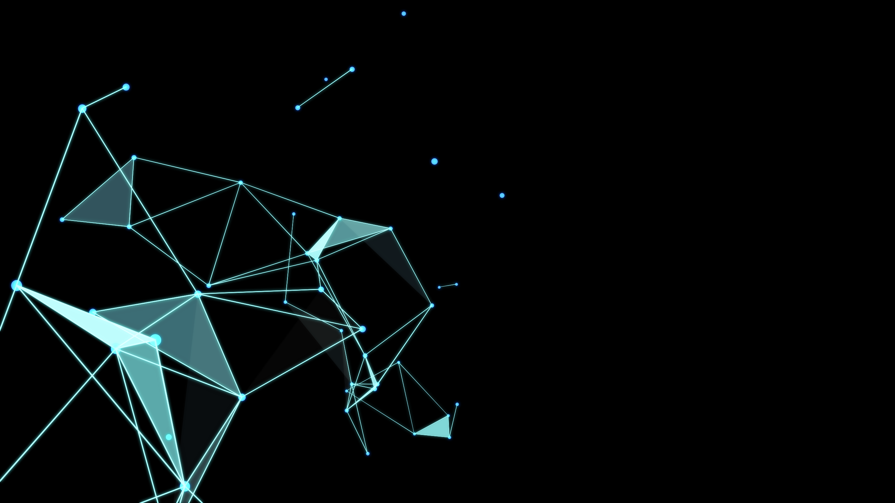

Move to AGI
Decentralized HuggingFace (Nostr-based decentralized AGI model storage protocol + AGI Git version control + SAAS private model Tokenomics)
AGI as a Service, GIT as a Service
Babel Open-Source Community
2024/3/31

Slide 2
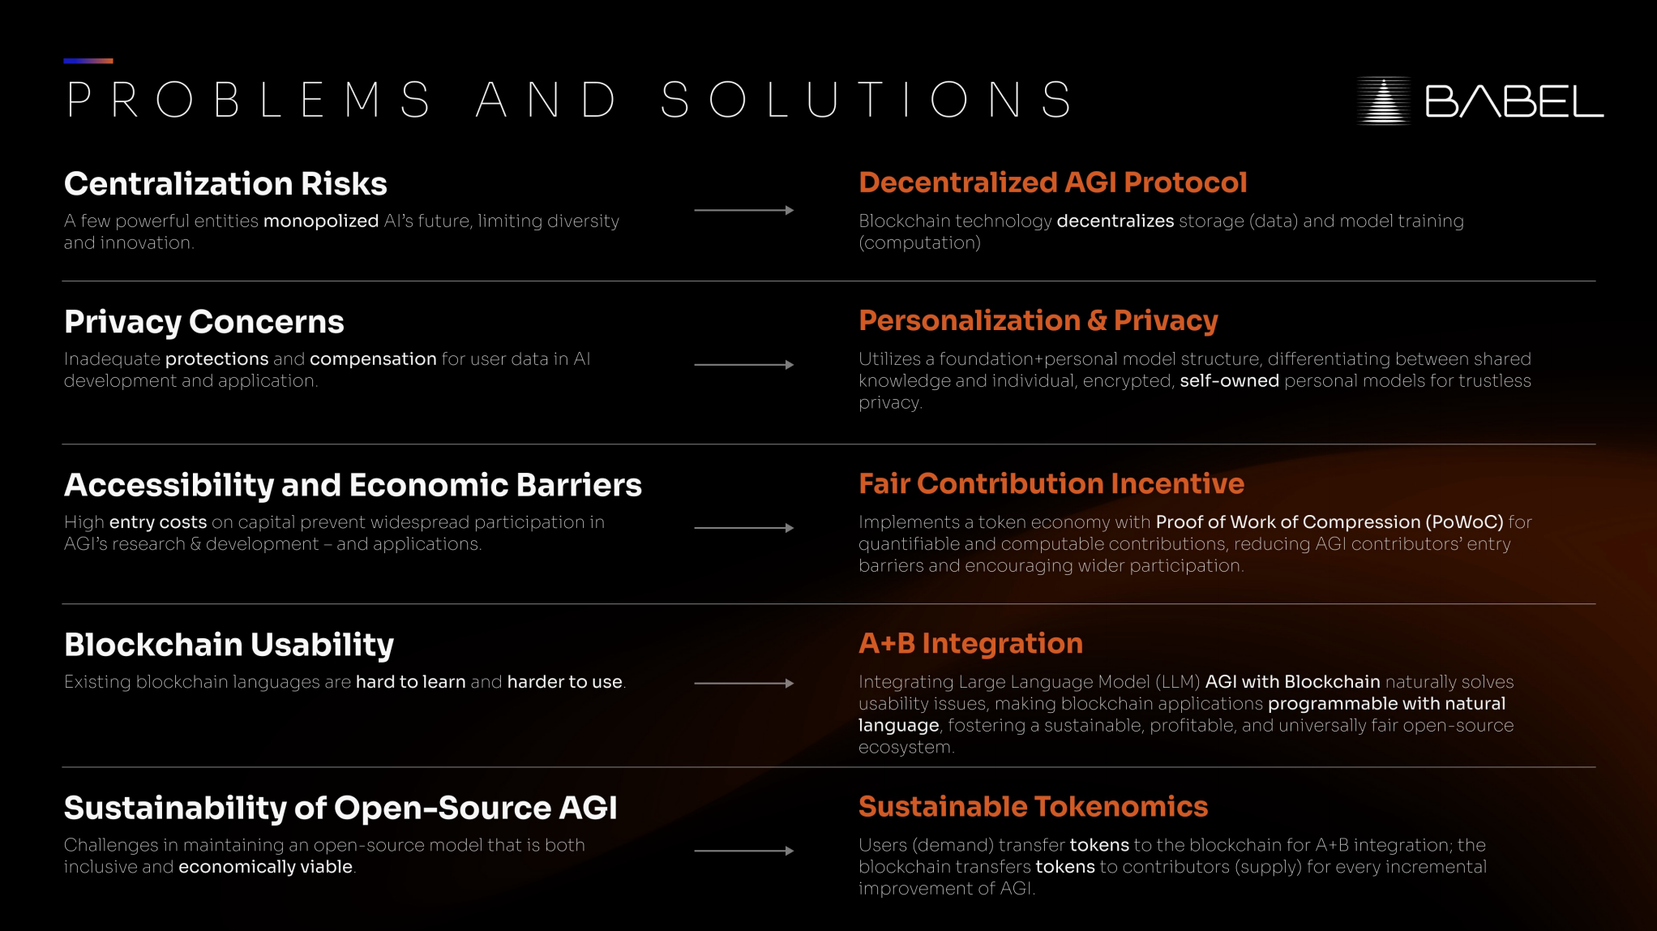
AGI Nostr
AGI Nostr+Token SAAS
Tokenomics
AGI +Move SmartContract
AGI Git+Token SAAS

Slide 3
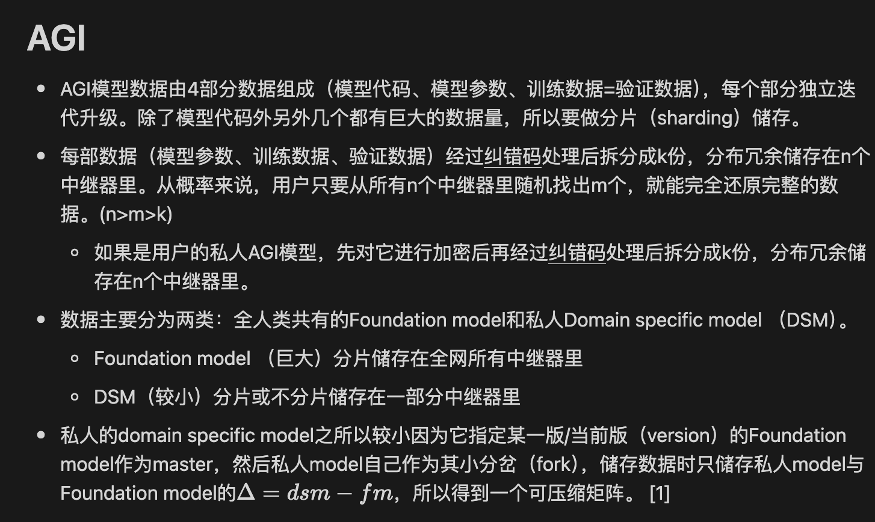
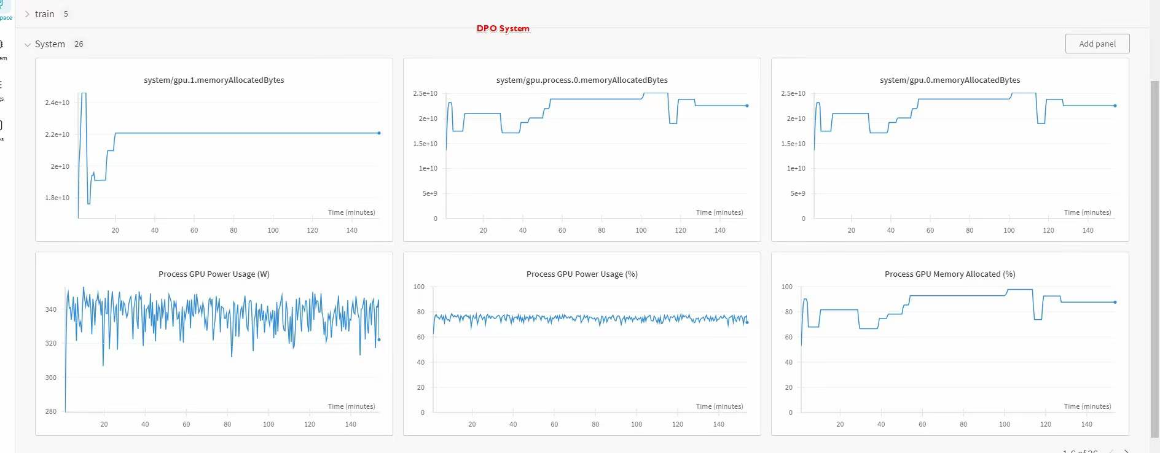
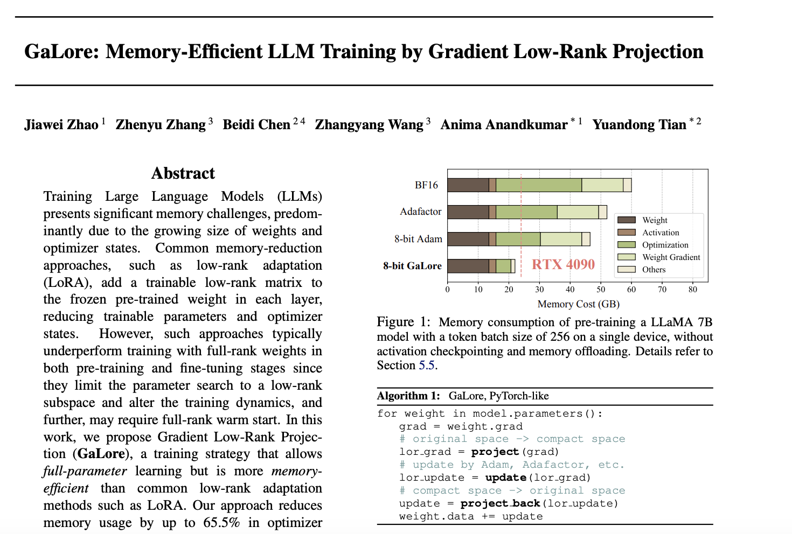
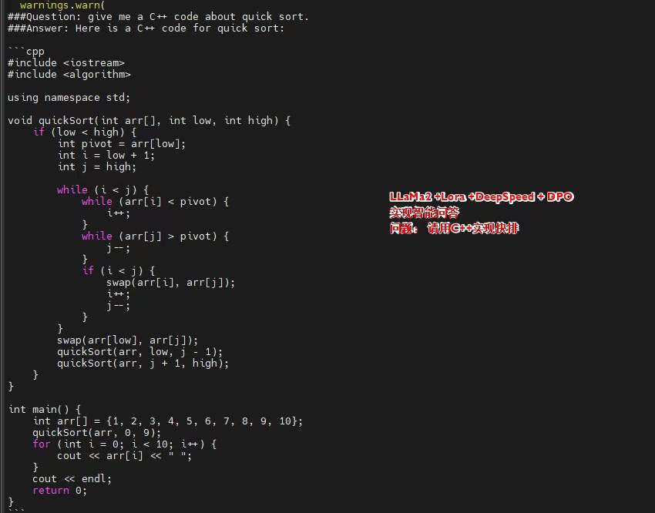
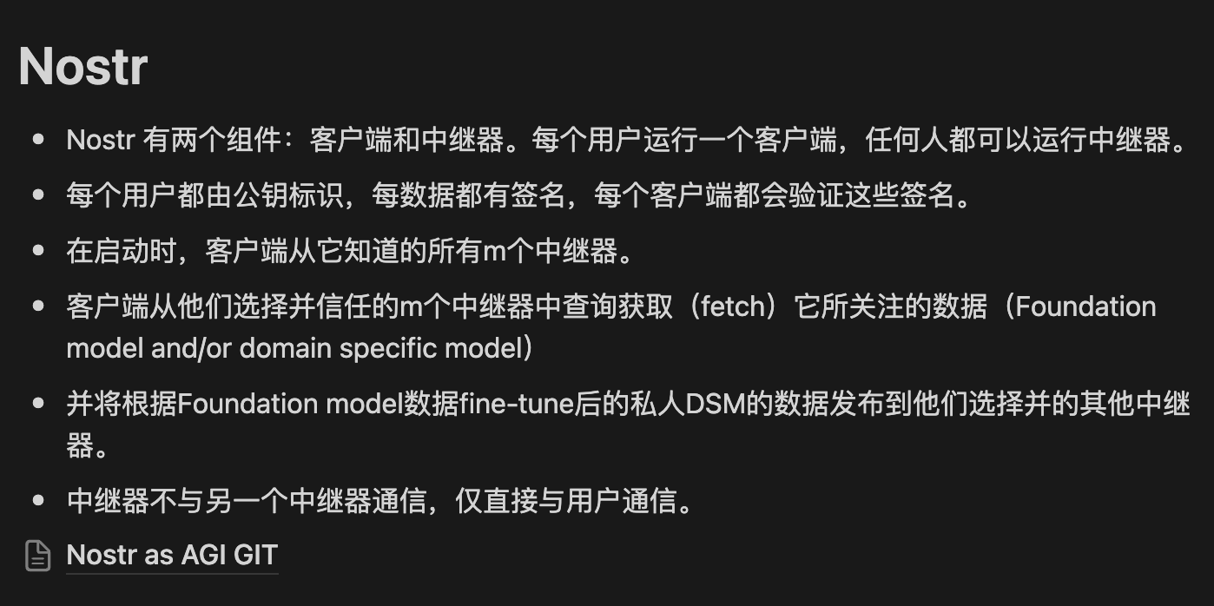
AGI Traning & Storage（Size：N-> ≈√N）

Slide 4
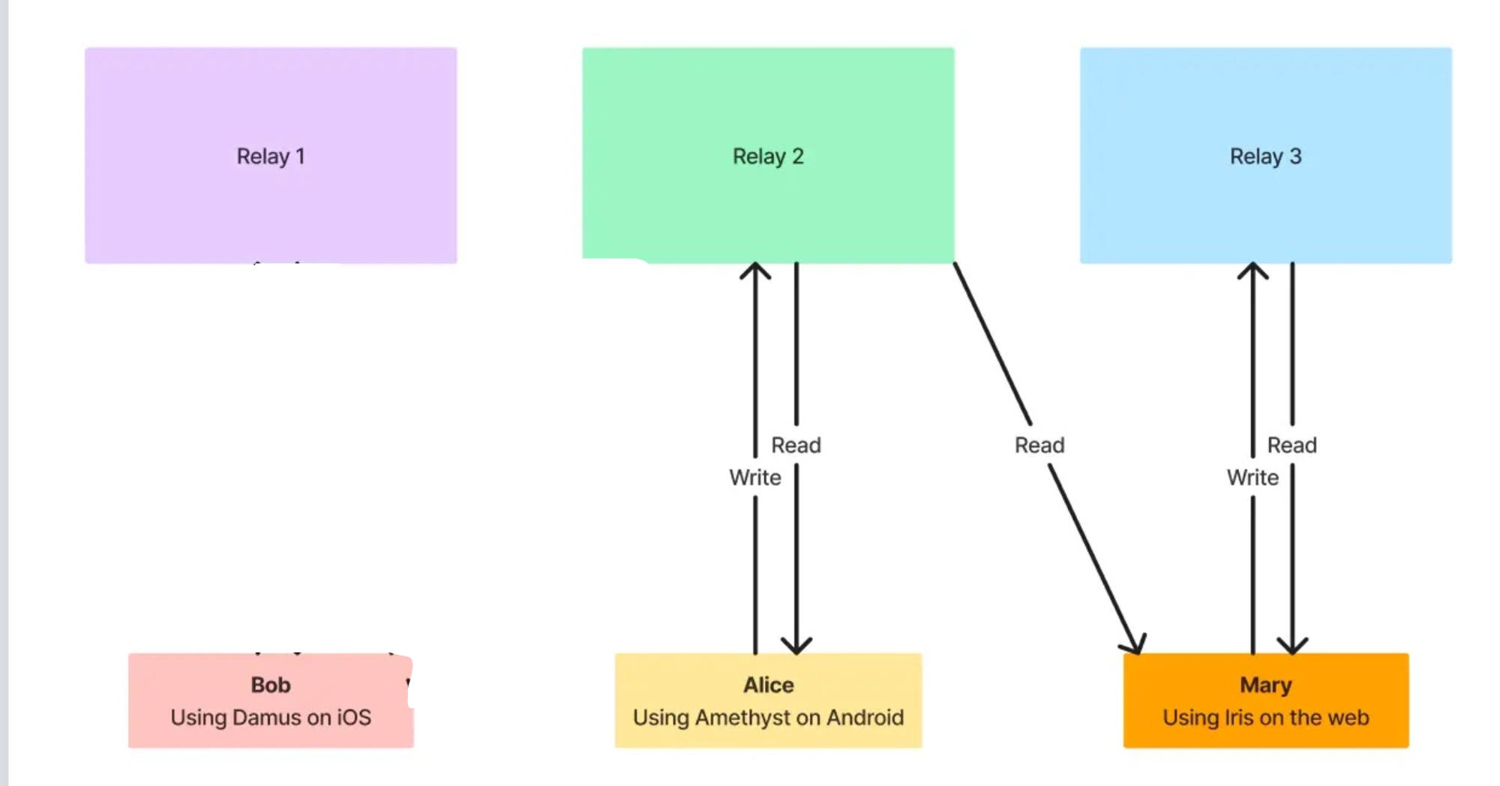
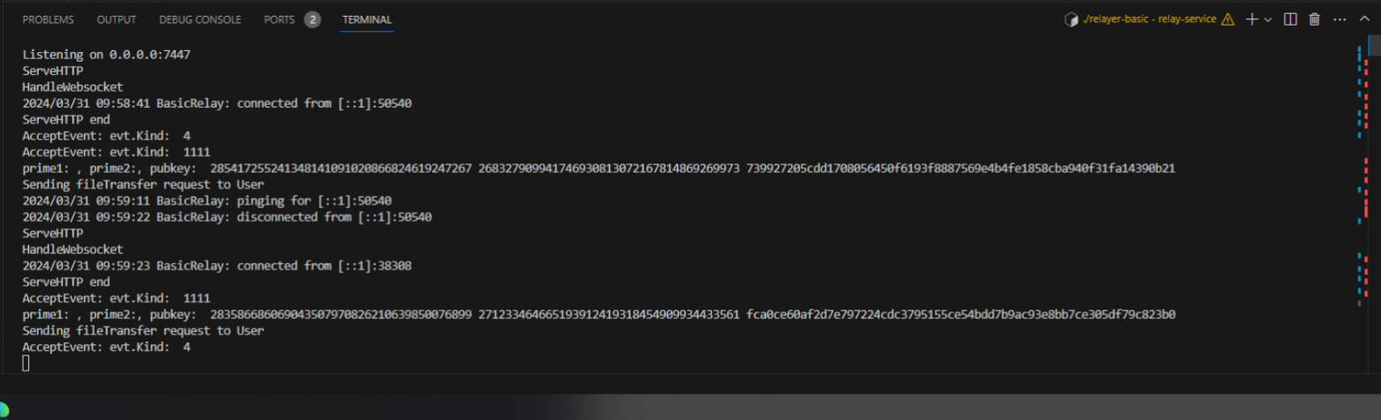
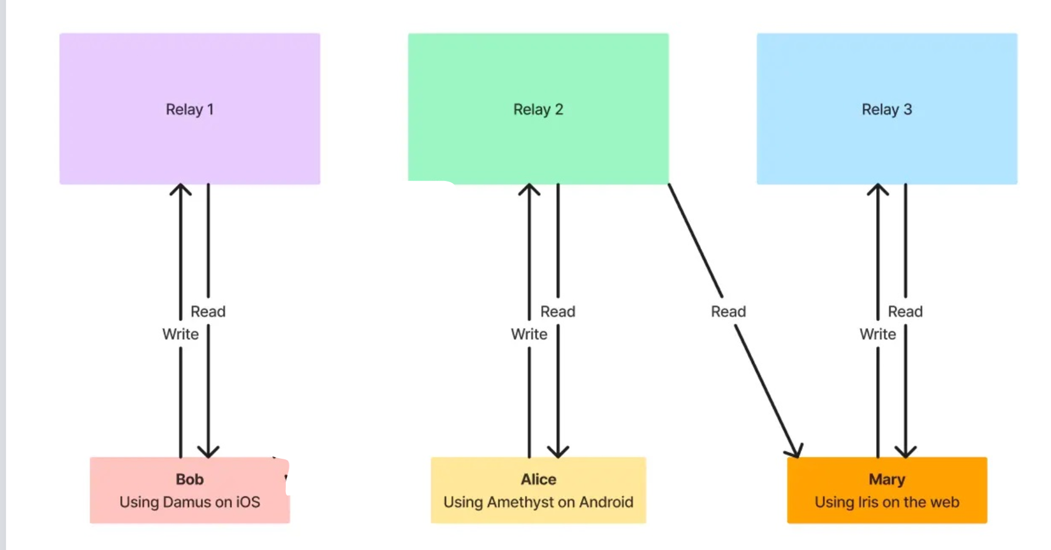
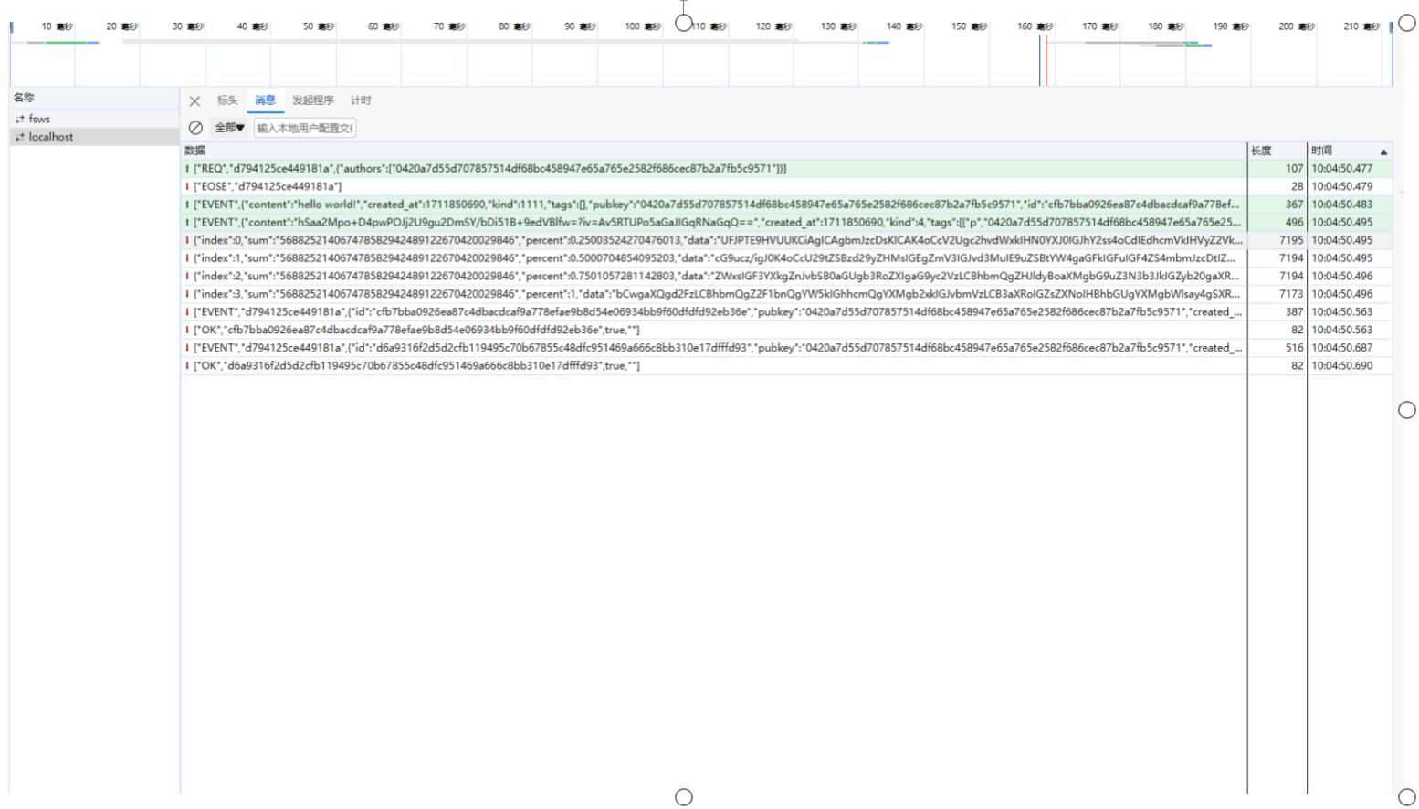
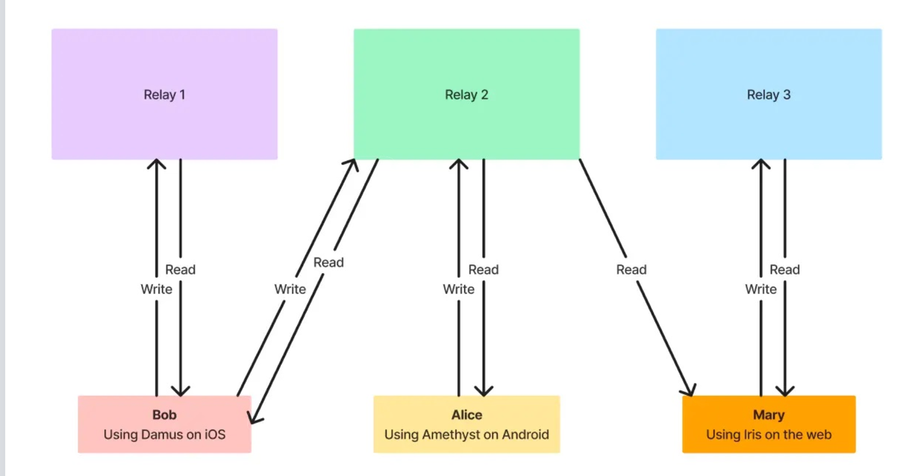
AGI Git
1.搭建nostr中继，并且连接postgresql数据库，前端
2.根据前端事件类型执行agigitPull命令
3.通过websocket的连接文件分块传输到客户端页面

Slide 5
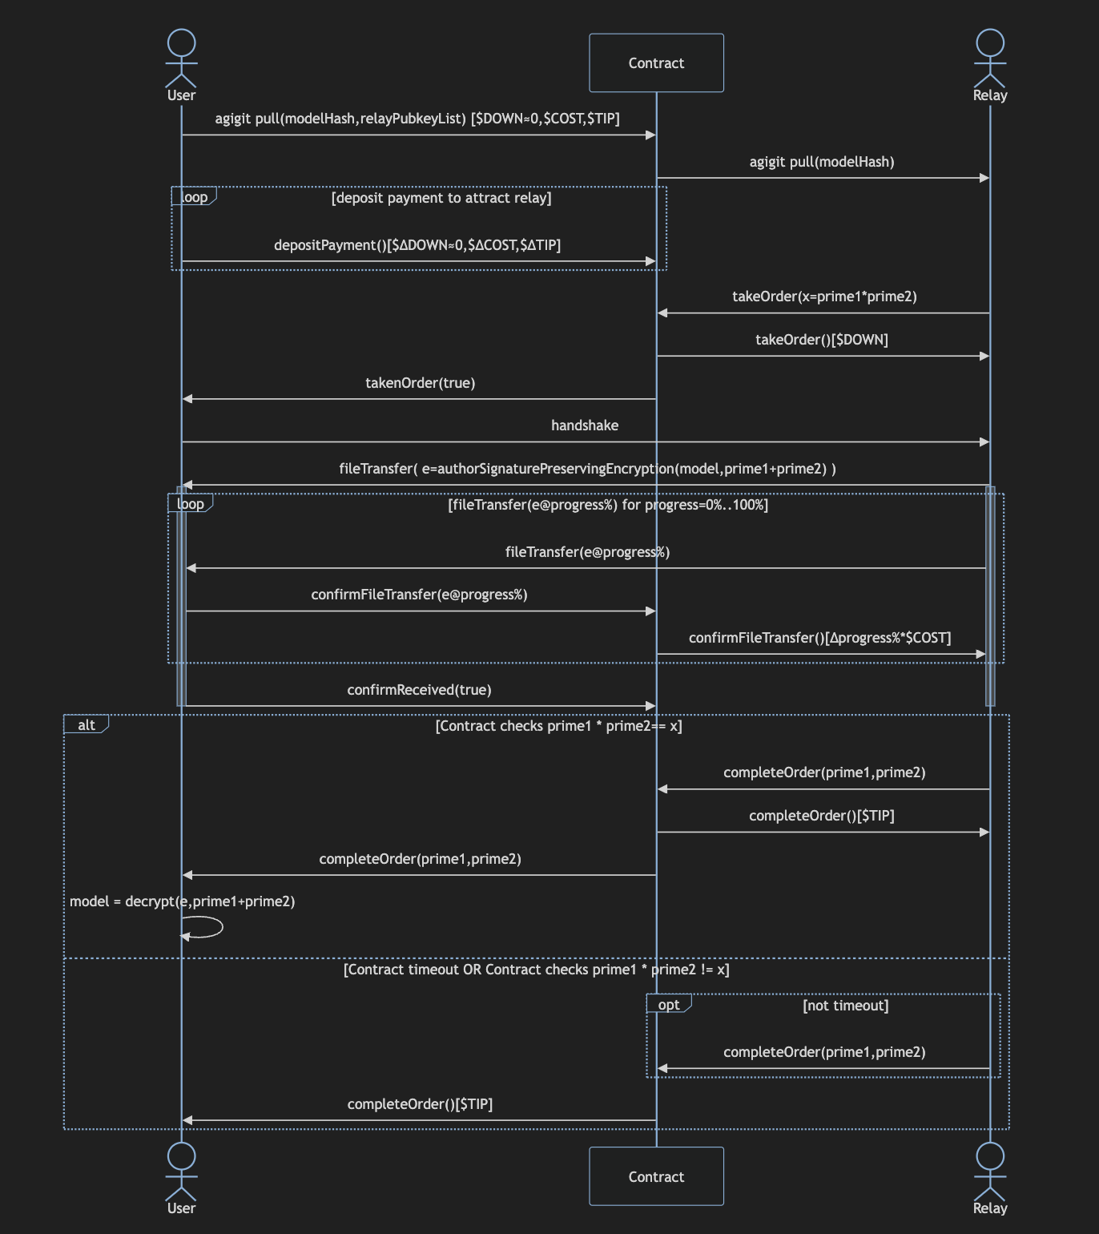
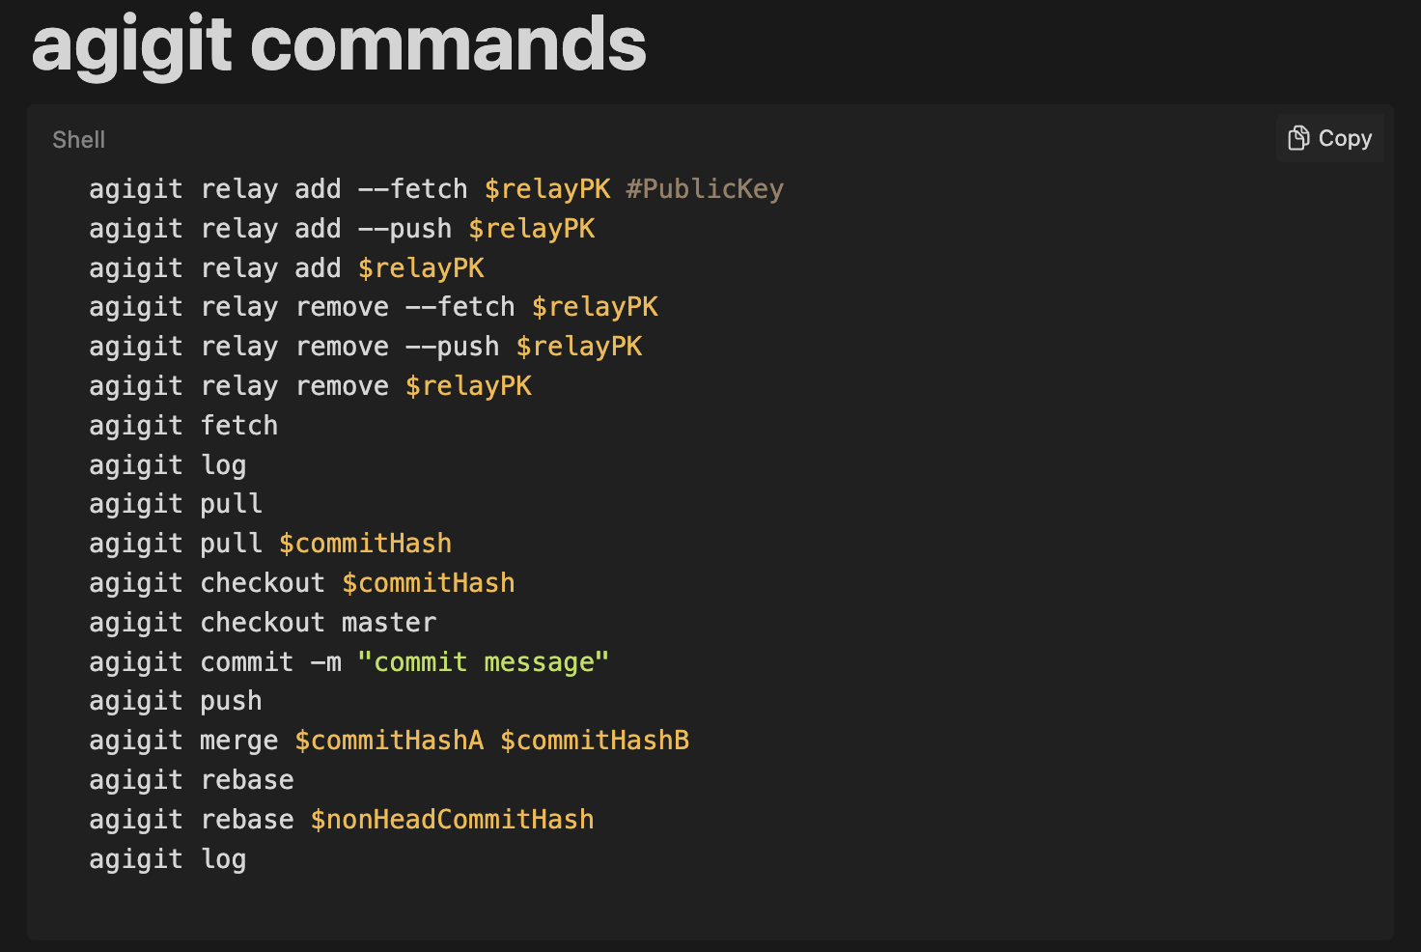
AGI Traning & Storage
Ecosystem of AGI trainers + blockchain miners + storage hosts
Tokenomics

Slide 6
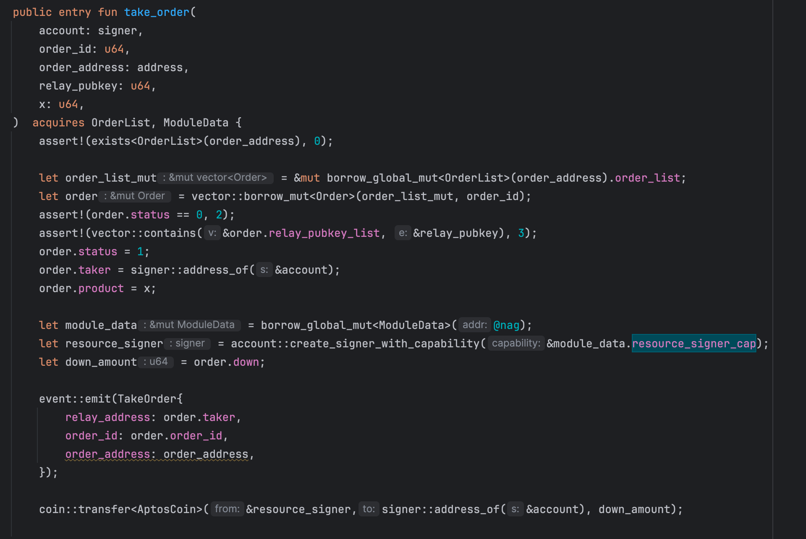
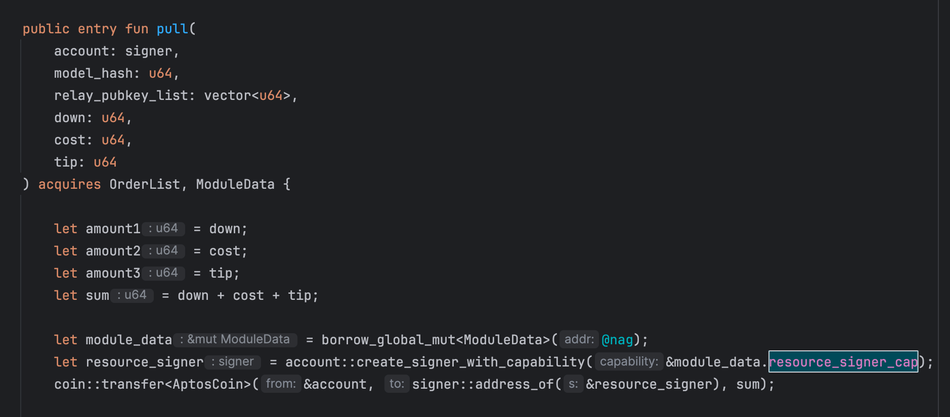
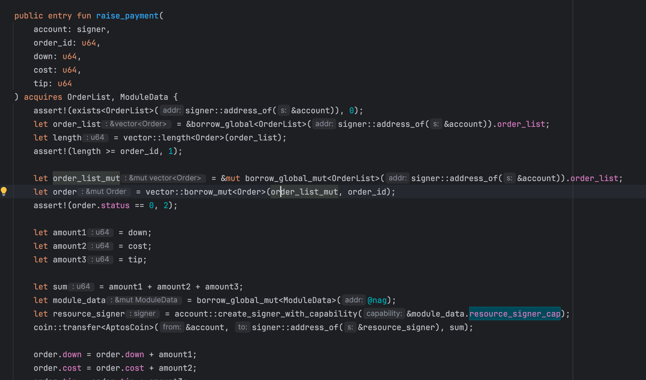
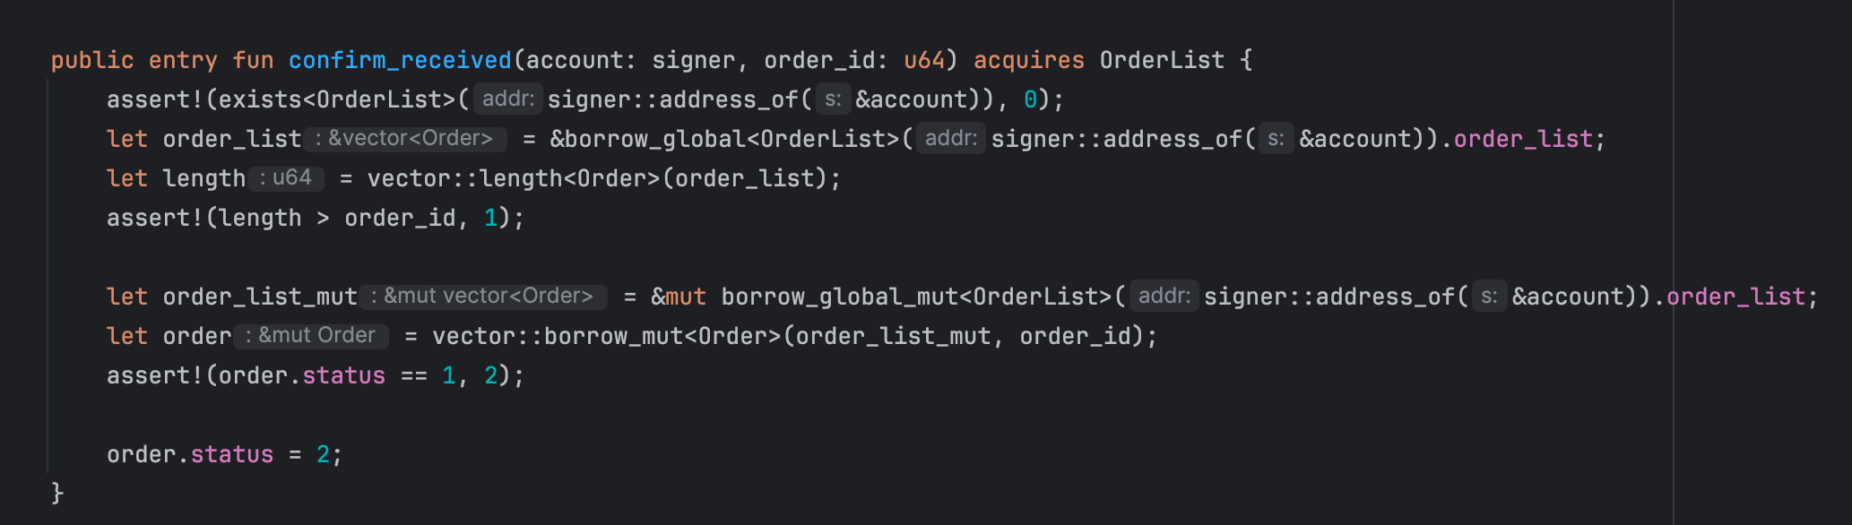
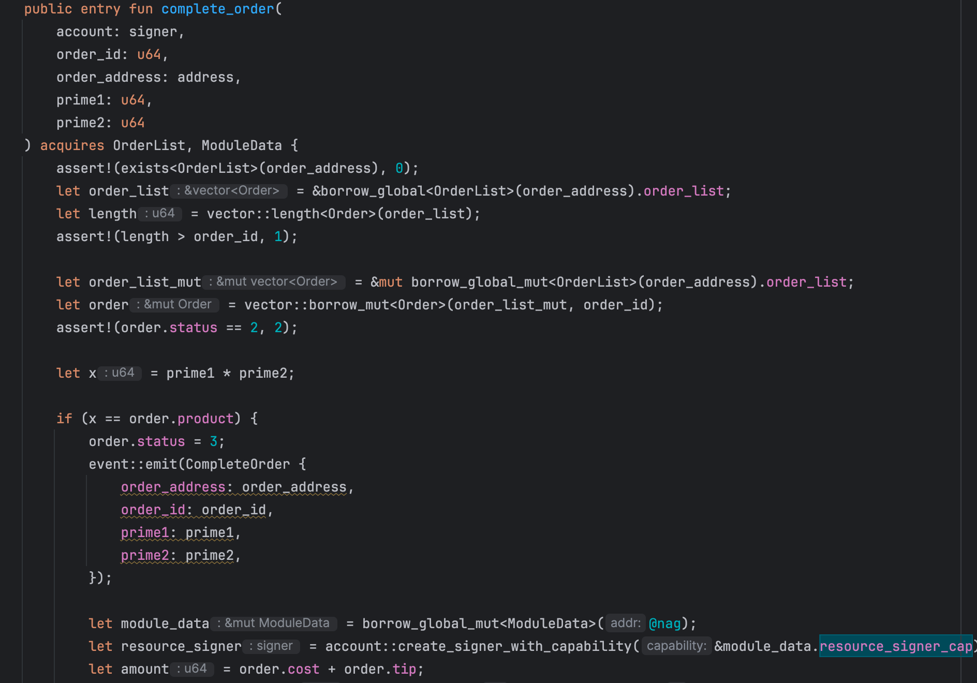
Move to AGI
Git as a Service
AGI as a Service
1. 用户发布订单
2. 用户追加费用
4. 用户确认已接收数据
5. 中继确认订单完成
3. relay接收订单

Slide 7
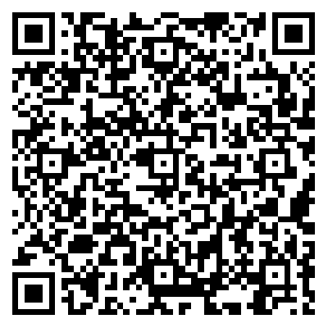
THANK YOU

